Slide 1
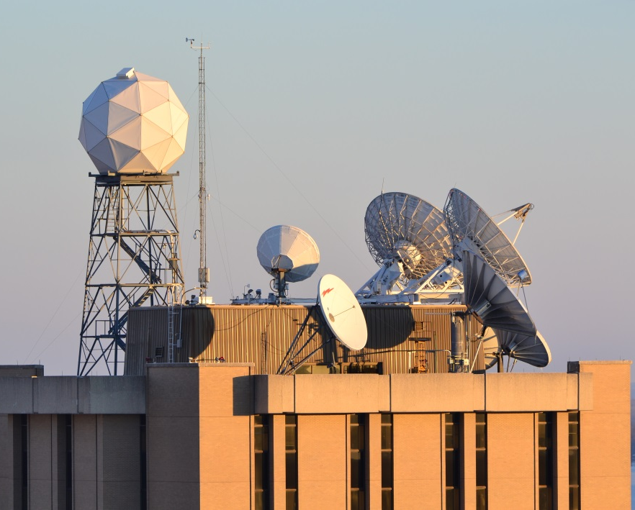
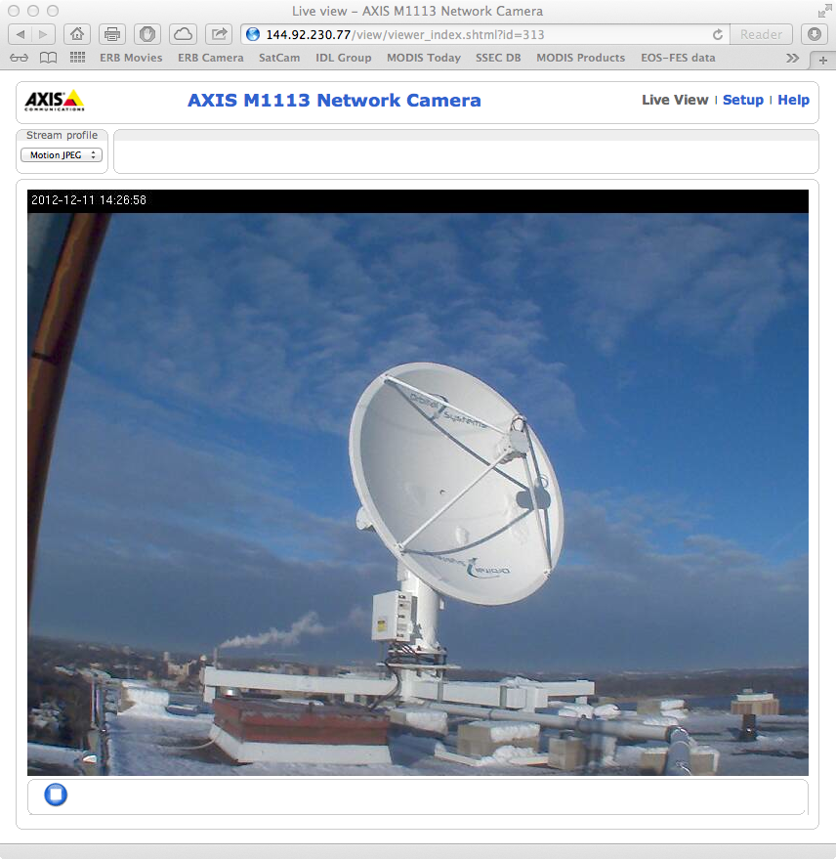


The Advancement of Community Based LEO and GEO Satellite Processing and Application Packages
Allen Huang, Liam Gumley, Kathy Strabala, Scott Mindock, Graeme Martin, Ray Garcia, Geoff Cureton, Jim Davies, Nick Bearson, Elisabeth Weisz, Nadia Smith, Bill Smith Sr. & many others
The Sixth Asia/Oceania Meteorological Satellite Users’ Conference
Tokyo, Japan
11 November, 2015

Slide 2
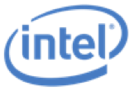
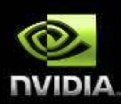

The Advancement of Community Based LEO and GEO Satellite Processing and Application Packages
Outline:
CIMSS Processing Packages: ITPP, IAPP, IMAPP, CSPP-LEO, CSPP-Geo
IMAPP (2014/2015) Overview
CSPP Overview
Innovations with new sponsors:
4.1 ISEE (Innovative Satellite Enhanced Exploration)
4.2 Technology Innovation for real-time Wx Forecasting
5. Summary

Slide 3
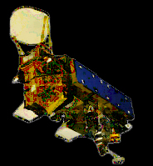
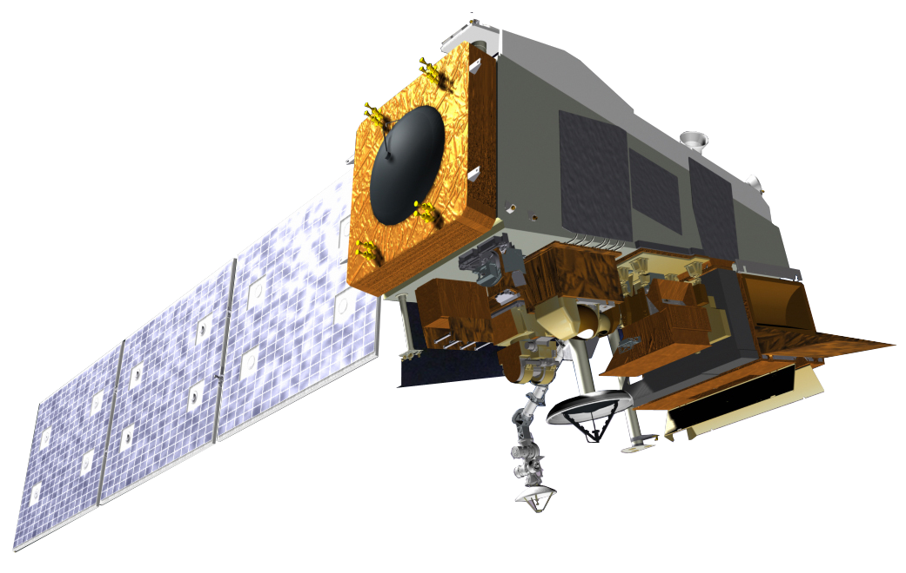
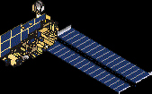
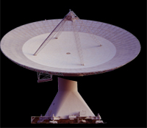

LEO Direct Broadcast Processing Packages
Schematic of LEO DB End-to-End Processing
Understanding of instrument design principals
Analysis of measurement characteristics
Development of processing algorithms
Signal to Data
Data to Products
Products to Information
L0/RDR
L1/SDR
L2/EDR
L3/UDR
L0-L1
L1-L2
L2-L3
Schematic of LEO DB End-to-End Processing -continue
Use of processing S/W System
Linkage to meteorological & environmental modeling & applications
L1/SDR
CrIS
VIIRS
ATMS
MODIS
AIRS
AMSU
AMSR-E
L2/EDR
MODIS/VIIRS
Images
TPW/SST
Clouds
Aerosol
AIRS/CrIS
C.C. Radiances
T/Q
Clouds
AMSR-E/ATMS
Soil Moisture
Precipitation
L3/UDR
Air Quality
Natural Resources
Management
Draught Monitoring
Nowcasting
Validation
Data Assimilation
Aviation Safety
Climate Study

Slide 4
From ITPP, IAPP, IMAPP to CSPP 1992 to 2015 (1/2)
1992: TOVS (TIROS-N) export package started
1993: 1st release of ITPP for NOAA-8
1999: 1st release of IAPP for NOAA-15
2000: 1st release of IMAPP for Terra MODIS
2002: 1st IMAPP science products released for Terra MODIS & 1st release for both Terra & Aqua MODIS
2004: 1st IMAPP training workshop at Nanjing, China
2005: 2nd & 3rd IMAPP training workshops & IAPP V2.1 released. 1st release of IMAPP AIRS/AMSU/HSB sounding rtv.
IMAPP: 61 releases since May 2000
CSPP: 29 releases since March 2012

Slide 5
From ITPP, IAPP, IMAPP to CSPP 1992 to 2015 (2/2)
2006: 1st IMAPP AMSR-E soil moisture & workshops in Norway & S. Africa
2007: IMAPP AMSR-E Snow Water Equivalent & workshop in Brazil
2008: 1st release of IMAPP DB-CRAS NWP model
2009: 1st release of Google Earth
2010: IMAPP Virtual Appliance
2012: CSPP 1st release for Suomi NPP & IDEA-I 1st release
2015: CSPP-IAPP for NOAA 15/16/18/19 & Metop A/B release
2015: CSPP-GEO for GOES GRB & GVAR
IMAPP: 61 releases since May 2000
CSPP: 29 releases since March 2012

Slide 6


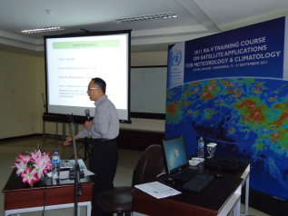
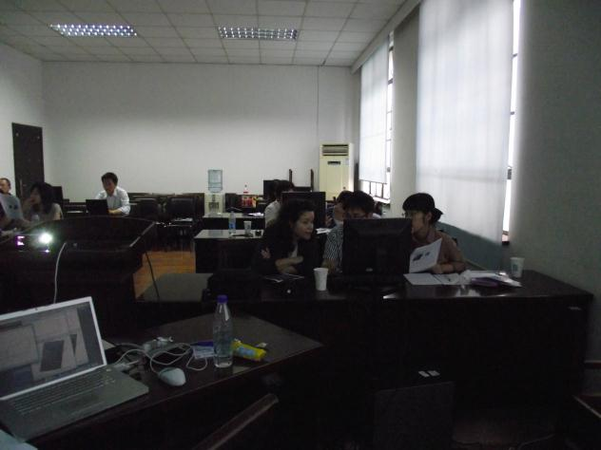
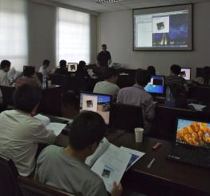
International MODIS/AIRS Processing Package
IMAPP - Funded by NASA since 2000
http://cimss.ssec.wisc.edu/imapp/
61 software packages released in 15 years
More than 3000 registrants from 76 different countries
12 direct broadcast workshops held on 6 continents serving students from more than 60 countries
15 MODIS related software packages
6 AIRS related software packages
4 AMSR-E software packages
Indonesia Workshop Sep. 2011
Shanghai Workshop June 2011

Slide 7
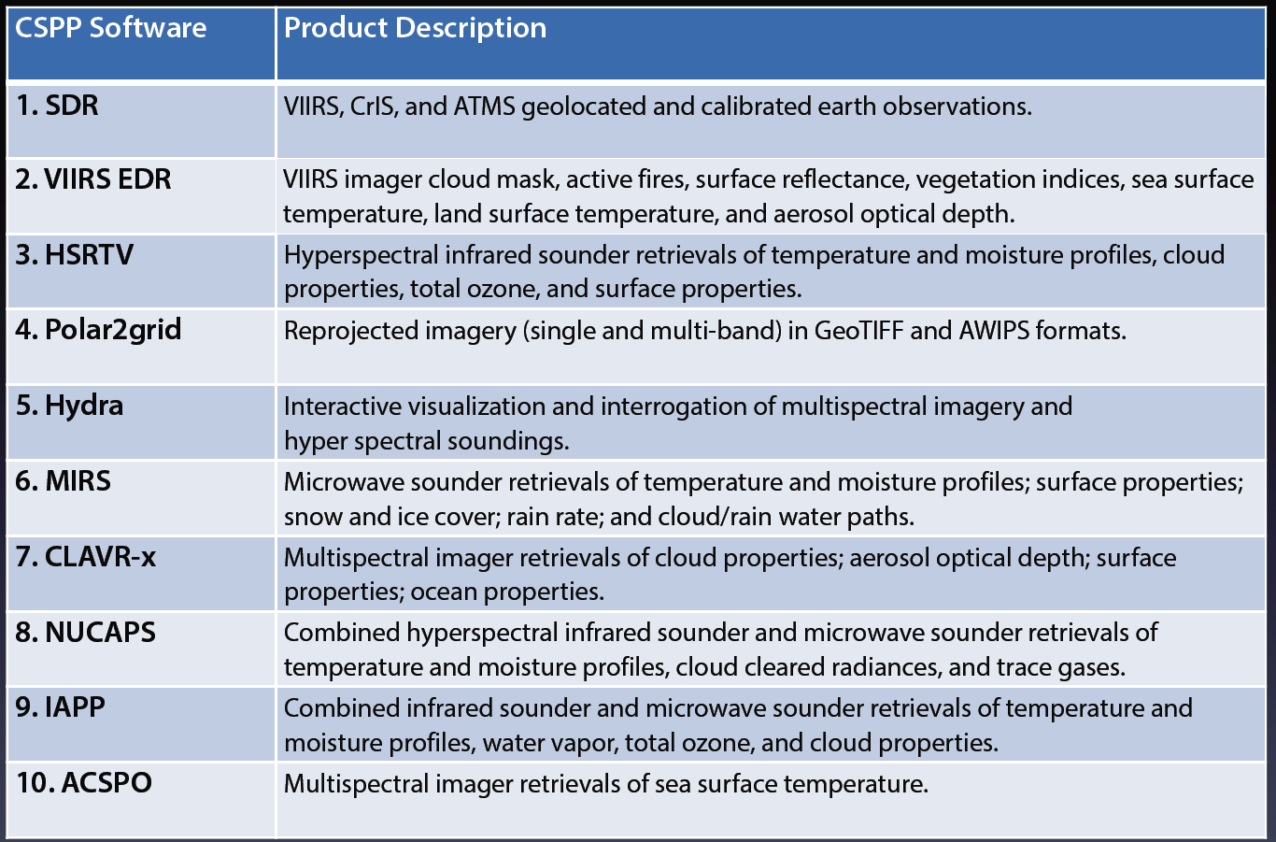
CSPP Software Suites

Slide 8
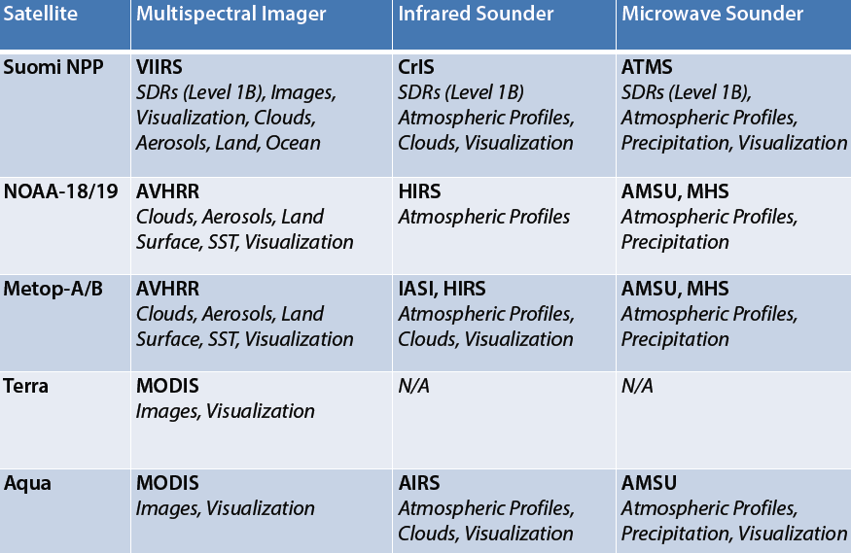
CSPP LEO covers multi sensors on board International Satellite Systems

Slide 9
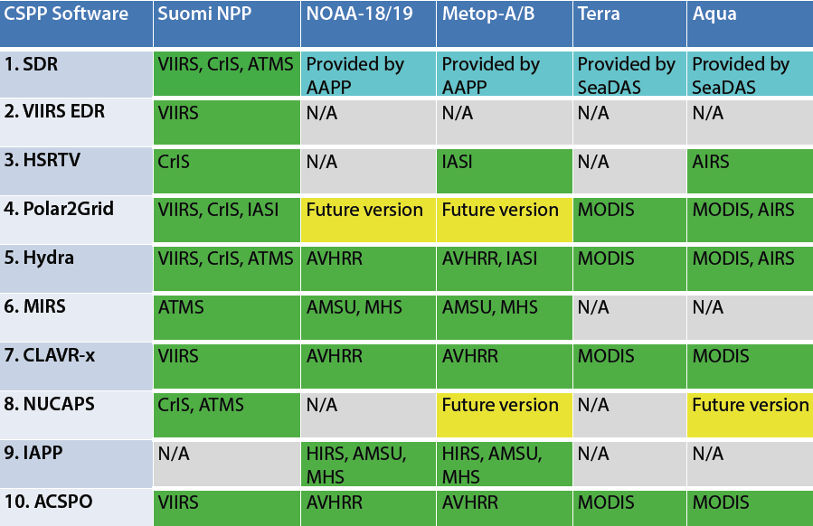
CSPP S/W Suite produces Imager/Sounder (VIS, IR, & MW) products and provides supporting tools

Slide 10
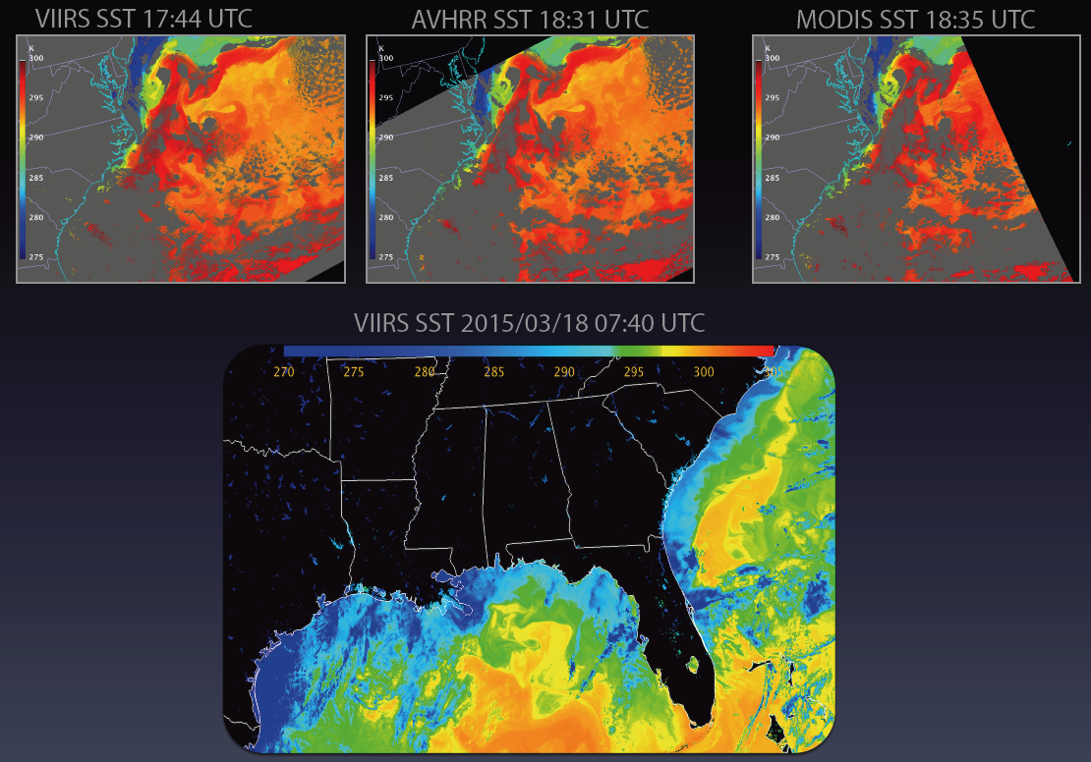
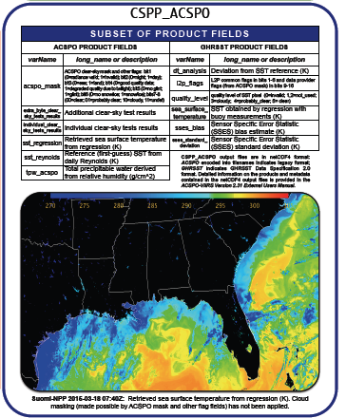
CSPP LEO S/W Suite provided by NOAA (1/4)
ACSPO (Advanced Clear-Sky Processor for Oceans) retrieves sea surface temperature from multispectral imager observations
Heritage: Developed at NOAA/NESDIS/STAR by Alex Ignatov, John Sapper,
John Stroup, and Yury Kihai.
Satellites/Sensors: Suomi NPP VIIRS; NOAA-18/19 AVHRR; Metop-A/B AVHRR; Terra/
Aqua MODIS.
Products: Sea surface temperature, aerosol optical thickness; and clear-sky
radiances.
Features:
• Multi-sensor common algorithm.
• ACSPO is the official JPSS
algorithm for SST.

Slide 11
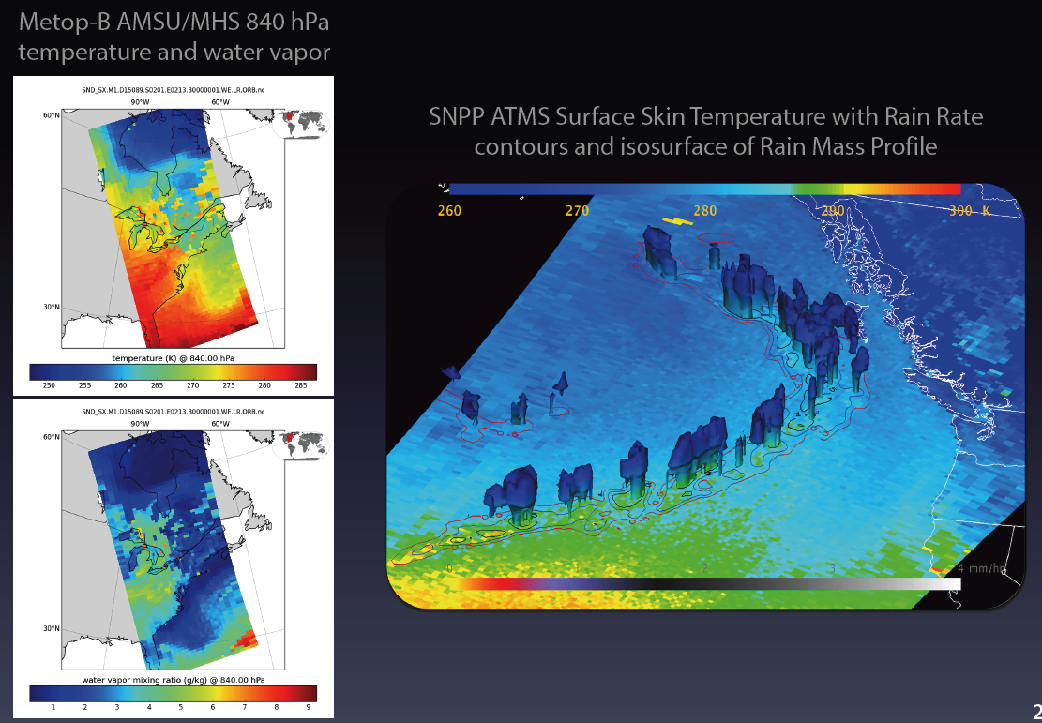
CSPP LEO S/W Suite provided by NOAA (2/4)
MIRS (Microwave Integrated Retrieval System) creates atmospheric profile, precipitation, and surface products from microwave sounder data -
Heritage: Developed at NOAA/NESDIS by Sid Boukabara, Chris Grassotti, et al.
Satellites/Sensors: Suomi NPP ATMS; Metop-A/B AMSU, MHS; NOAA-18/19 AMSU, MHS.
Products: Temperature and moisture profiles, total precipitable water, surface skin temperature and emissivity, rain rate, cloud liquid water, rain water path, ice water path, liquid water path, sea ice concentration, snow water equivalent, and snow cover.
Features:
• Multi-sensor common
algorithm.
• Physics-based retrieval.
• Retrieves land and ocean
products in all sky conditions.
• Extensively validated and
documented

Slide 12
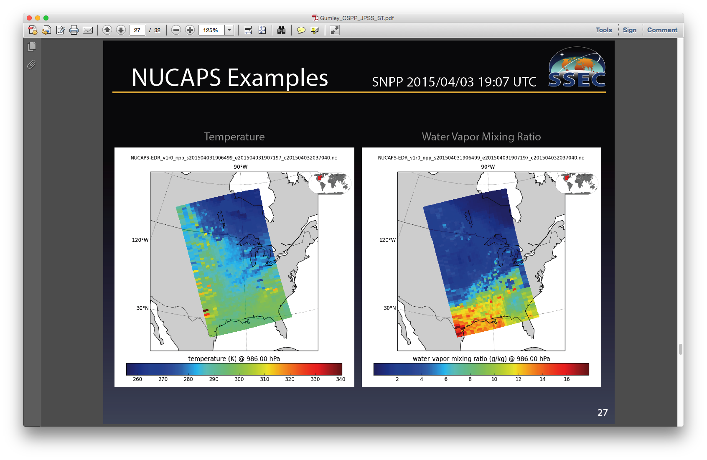
CSPP LEO S/W Suite provided by NOAA (3/4)
NUCAPS (NOAA Unique CrIS/ATMS Processing System) retrieves atmospheric temperature, moisture, and trace gases from combined infrared and microwave observations.
Heritage: Developed at NOAA/NESDIS/STAR by Chris Barnet, Antonia
Gambacorta, Walter Wolf, Mark Liu et al.
Satellites/Sensors: Suomi NPP CrIS/ATMS
Products: Temperature, water vapor, and ozone profiles; trace gas profiles
including ozone, carbon monoxide, methane, carbon dioxide,
nitrous oxide, sulphur dioxide; infrared and microwave surface
emissivity; cloud cleared radiances.
Features:
• Multi-sensor common physical retrieval algorithm.
• Future versions will support Metop-A/B IASI/AMSU/MHS and
Aqua AIRS/AMSU.
• NUCAPS is the official NOAA sounding product for JPSS.

Slide 13
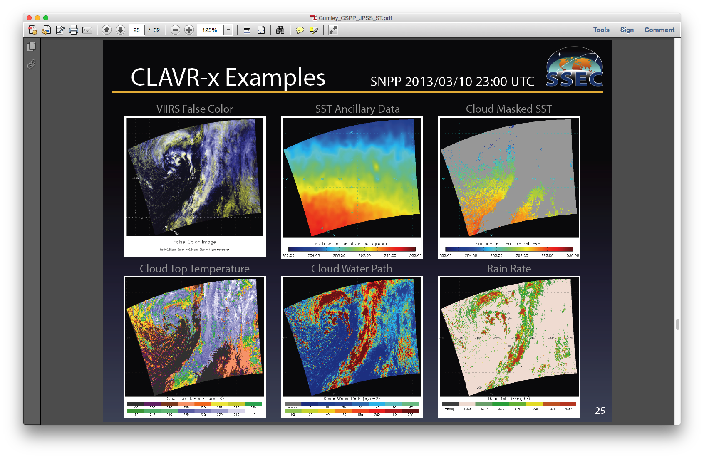
CSPP LEO S/W Suite provided by NOAA (4/4)
CLAVR-x (Clouds from AVHRR Extended) creates quantitative cloud, aerosol, and surface products from imager data
Heritage: Developed at NOAA/NESDIS/STAR and CIMSS/SSEC by Andy
Heidinger, Andi Walther, Denis Botambekov, et al.
Satellites/Sensors: Suomi NPP VIIRS; Terra/Aqua MODIS; Metop-A/B AVHRR; NOAA-18/19 AVHRR.
Products: Cloud mask, type, fraction, and phase; cloud top height, pressure, temperature, and emissivity; cloud optical depth and effective radius; aerosol optical thickness; normalized difference vegetation index; sea surface temperature; all in HDF4 format.
Features:
• Multi-sensor common algorithm.
• Product files include cloud and surface products,
calibrated observations, and many ancillary data
fields (user controlled).
• CLAVR-x is the official
NOAA cloud product for JPSS

Slide 14
CSPP Software Release: Microwave Integrated Retrieval System for ATMS, AMSU-A, and MHS Version 2.0 – 12 October, 2015
The Community Satellite Processing Package (CSPP) project is pleased to announce an updated release of the NOAA/NESDIS/STAR Microwave Integrated Retrieval System (MIRS) ……
What is New is CSPP MIRS Version 2.0:
* Base NOAA software has been upgraded from v9.2 to v11.1.
* NOAA-18, NOAA-19, Metop-A and Metop-B retrievals are now produced by default at the resolution of the MHS instrument, with AMSU-A data interpolated to match.
* Product arrays stored as scaled integers now have different scaling attributes. The "scale" divisor (100) attribute has changed to a multiplier (0.01) named "scale_factor". This was to bring the product into Climate and Forecast (CF) standards compliance. The stored integer values have not changed, so that a brightness temperature of 273.15K, for example, is still represented by an integer value 27315.
Supported satellites, sensors, and data include:
* Suomi NPP ATMS SDR (from CSPP or CLASS)
* NOAA 18 and 19 AMSU-A and MHS Level 1B (from AAPP)
* Metop-A and Metop-B AMSU-A and MHS Level 1B (from AAPP)
Official Validated Products created by MIRS include:
* Temperature profile over open water ocean
* Humidity profile over open water ocean
* Humidity profile over non-coastal Land
* Total Precipitable Water (TPW) over open water ocean………
Experimental Products (not fully validated) created by MIRS include:
* Cloud Liquid Water Profile (CLWP) over ocean…….
System requirements for the CSPP_MIRS v2.0 software are as follows:
* Intel or AMD CPU with 64-bit instruction support,
* 1 GB RAM
* CentOS-6 64-bit Linux (or other compatible 64-bit Linux distribution),
* 1 GB of disk space (plus space for your own DB data and CSPP_MIRS products).

Slide 15
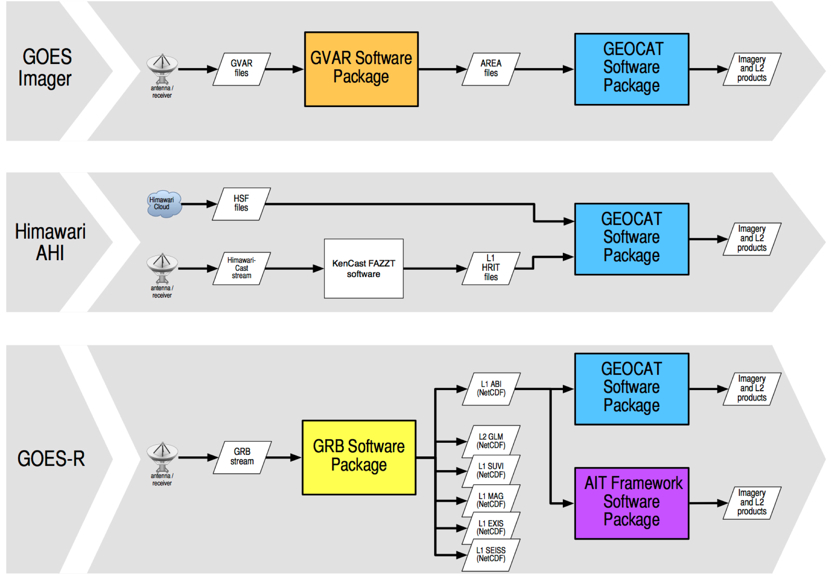
CSPP-GEO GOES-GVAR, ABI-GRB & AHI Processing S/W

Slide 17
Version 1.0
released
Version 0.1
released

Slide 18
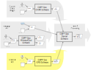
CSPP Geo GRB software
Ingests raw GRB stream, extracts payloads from packets and constructs datasets
Primarily new Python code, NASA RT-STPS used for ingest
Tested with Harris GRB simulator, DOE data
High data rate drives software design and hardware spec
GRB V0.1 prototype released March 2015
Creates ABI Level 1 and GLM Level 2 datasets
Writes output to NetCDF4 files
Test dataset provided
Software and documentation available from website: http://cimss.ssec.wisc.edu/csppgeo/
Includes ICD describing planned upstream data interface
Planning new releases ~every 3 months, eventually support all GOES-R instruments
GRB minimum hardware requirements
12 core, 2.4 GHz CPU with 64-bit instruction support
32GB RAM
CentOS 6 64-bit Linux (or other compatible 64-bit Linux distribution
100 GB disk space

Slide 19
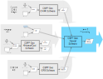
CSPP Geo GEOCAT software
Initial version will support GOES Imager and produce
cloud products (Andrew Heidinger, NOAA/STAR)
fog / low stratus (Mike Pavolonis, NOAA/STAR)
Later versions will add support for AHI and ABI, add other L2 products and algorithm updates
Ancillary data will be served from SSEC / CIMSS via the internet
Design challenges:
Some L2 algorithms use data from previous timesteps; so all images must mapped to same projection
High data rate will require parallelization and substantial hardware
Initial release summer 2015
Estimated system requirements*
CPU: Intel Xeon E5 v2 “Ivy Bridge”, 20-core (2 x 10-core), 2.8GHz
RAM: 192GB
Disk: 14TB (does not include long-term storage)
* includes imagery, clouds, fog, winds and hurricane intensity estimation

Slide 20
CSPP Geo software release: GRB v0.3 Prototype 6 October, 2015
The CSPP Geo GRB Version 0.3 Prototype software package is now available for download. This is the final planned prototype release of software that will allow direct broadcast users to process data received from the GOES-R satellite after it is launched in 2016. The software is publicly available and free to use.
The main new capabilities included in this release are:
Creates Level 1 products from the two remaining instruments, EXIS and SUVI. All six GOES-R instruments are now supported.
Added options for improved configurability
Output is written to mission-standard NetCDF-4 files. Optionally, quicklooks can be generated from the ABI radiance product.
The minimum system requirements for the CSPP Geo GRB software are (same as previous releases):
12 core, 2.4 GHz CPU with 64-bit instruction support,
32GB RAM,
CentOS 6 64-bit Linux (or other compatible 64-bit Linux distribution),
100 GB disk space
Root access may be needed on the target machine to configure network buffer settings to the recommended sizes.
A test data package is provided, including scripts that simulate the GRB data stream by sending artificial data for each of the supported instruments over two sockets. In our internal testing, the software was able to keep up with the expected GRB data rate without packet loss when running on the recommended hardware.
The future version 1.0 release will include performance optimizations, and any changes that are needed to process mission data. We plan to release version 1.0 beta before launch, and the final version 1.0 after any issues have been resolved and correct processing of mission data has been verified.
The CSPP Geo GRB software and documentation can be downloaded from:
http://cimss.ssec.wisc.edu/csppgeo/

Slide 21
The Advancement of Community Based LEO and GEO Satellite Processing and Application Packages
Outline:
CIMSS Processing Packages: ITPP, IAPP, IMAPP, CSPP-LEO, CSPP-Geo
IMAPP (2014/2015) Overview
CSPP Overview
Innovations with new sponsors:
4.1 ISEE (Innovative Satellite Enhanced Exploration)
4.2 Technology Innovation for real-time Wx Forecasting
5. Summary

Slide 22

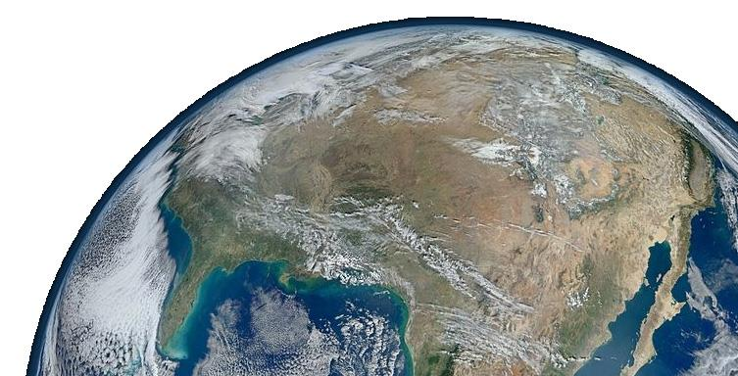
ISEE Scenario
Event is seen, investigated & understood with ISEE
Event on Earth: fire, flood, volcano, algal bloom, pollution, fog, severe wx, & unusual phenomenon
S-NPP/JSPP Satellite Observation – Primary
Integrated with other Data/Information
Direct Broadcast to SSEC & expand to NOAA DBRTN (Direct Broadcast Real-Time Network) – Real Time
Processing into ISEE servers
Notification pushed to subscribers’ cell phones
Sharing of event: Web, App, Facebook, Twitter, email, blog

Slide 23
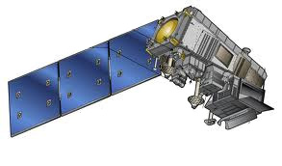
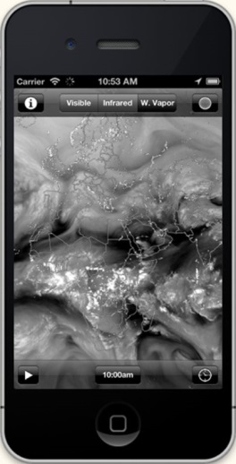





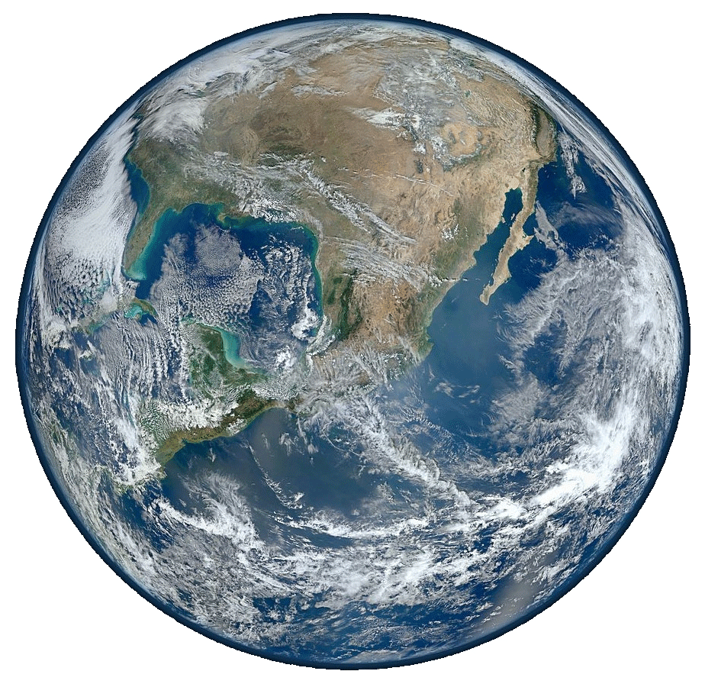


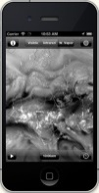






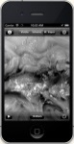

ISEE Synopsis 1st Gen
“I See!”
S-NPP
“I See!”

Slide 24

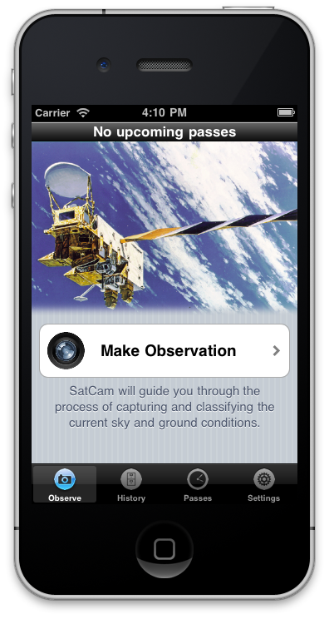
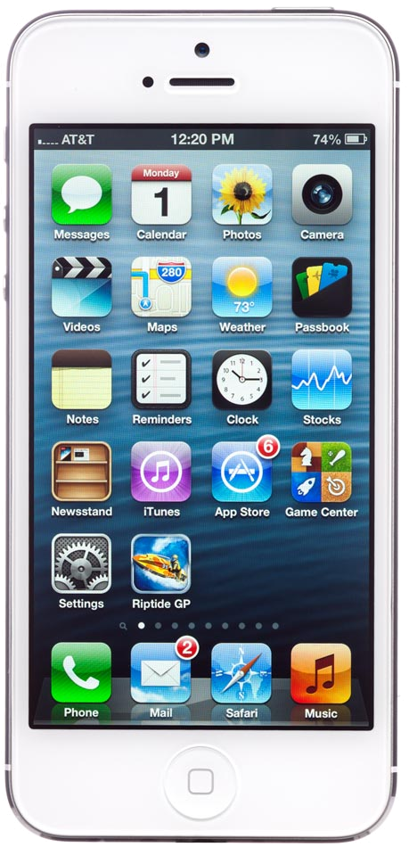
ISEE: Greater than the sum of its parts
Data processing – DB, Data Center, and RealEarth Servers
Social Media Sharing – CIMSS Blog, Twitter, via RealEarth Browser
Mobile display of data – WxSat
Notifications – SatCam
Simplification – (all the above)

Slide 25
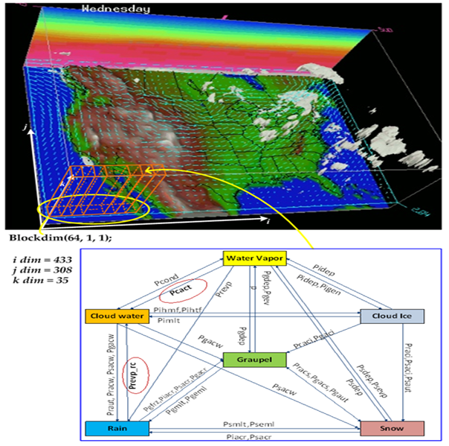
CUDA-based GPU accelerated WRF modules
WRF Module name | Speedup vs. one thread on 1.8Ghz Sandy Bridge (gfortran v.4.6.2)
Single moment 6-class microphysics | 500x
Eta microphysics | 272x
Purdue Lin microphysics | 692x
Stony-Brook University 5-class microphysics | 896x
Betts-Miller-Janjic convection | 105x
Kessler microphysics | 816x
New Goddard shortwave radiance | 134x
Single moment 3-class microphysics | 331x
New Thompson microphysics | 153x
Double moment 6-class microphysics | 206x
Dudhia shortwave radiance | 409x
Goddard microphysics | 1311x
Double moment 5-class microphysics | 206x
Total Energy Mass Flux surface layer | 214x
Mellor-Yamada Nakanishi Niino surface layer | 113x
Single moment 5-class microphysics | 350x
Pleim-Xiu surface layer | 665x

Slide 26
Accelerator-based (GPU/MIC) WRF model development at SSEC/CIMSS UW-Madison
- Will greatly benefit high resolution regional forecasting real-time capability
Intel awarded SSEC a two-year grant to develop Intel MIC Xeon Phi Coprocessor based WRF using open ACC common architecture
SSEC becomes one of the Intel Parallel Computing Center (IPCC)
Open Source with minimum changes to WRF existing code structure
Less time consumption to adopt/adapt
Projected speedup is about <10
NVIDIA, world largest GPU chip maker, is considering funding SSEC to develop a GPU-CPU Hybrid WRF prototype using CUDA architecture
CUDA based unique architecture
Need time consuming code porting & optimization
Projected speedup is about ~100
IBM Power architect, WRF experiment with POWER CPU+ NVIDIA GPU
TQI, GPU/CUDA based WRF for Low Latency Wx Forecast applications

Slide 27
The Advancement of Community Based LEO and GEO Satellite Processing and Application Packages
Summary
With strong support from NASA & NOAA support, SSEC/UW is committed to fully support NASA & NOAA Direct Readout/Broadcast activities to:
Maintain existing DB Processing Packages (i.e. IMAPP) for MODIS and AIRS and to develop new capabilities/applications and package for NPP/JPSS (CSPP, LEO/GEO), & METOP (L1-L2 PP) systems.
Upgrade DB real-time processing system efficiency, functions, and effort in enhancing Numerical Weather Prediction (DBCRAS->GPU-WRF) and air quality model (IDEA-I) and other applications to directly assimilate real time products (i.e. clouds, water vapor, and aerosol) to optimize broad use of DB products.
Support NOAA NNWS offices & Real-Time DB users in the efficient and broad use of the current and future polar orbiting satellite data/information.
Offer DB users training workshops in processing algorithms, S/W package operations and real-time applications
Organize CSPP/IMAPP Users’ Group meeting as often as needed
Innovate to support JPSS/GOES-R program goal and program Scientists’ vision

Slide 28
The Advancement of Community Based LEO and GEO Satellite Processing and Application Packages
Thank you for your attention
Questions are welcomed
CSPP Team
CSPP LEO:
Allen Huang, Liam Gumley, Kathy Strabala, Scott Mindock, Ray Garcia, Graeme Martin, Geoff Cureton, Elisabeth Weisz, Nadia Smith, Nick Bearson, James Davies, Jessica Braun
CSPP GEO:
Liam Gumley, Graeme Martin, Kathy Strabala, Scott Mindock, Geoff Cureton, Jessica Braun, Nick Bearson, Ray Garcia, Tommy Jasmin

